Slide 1
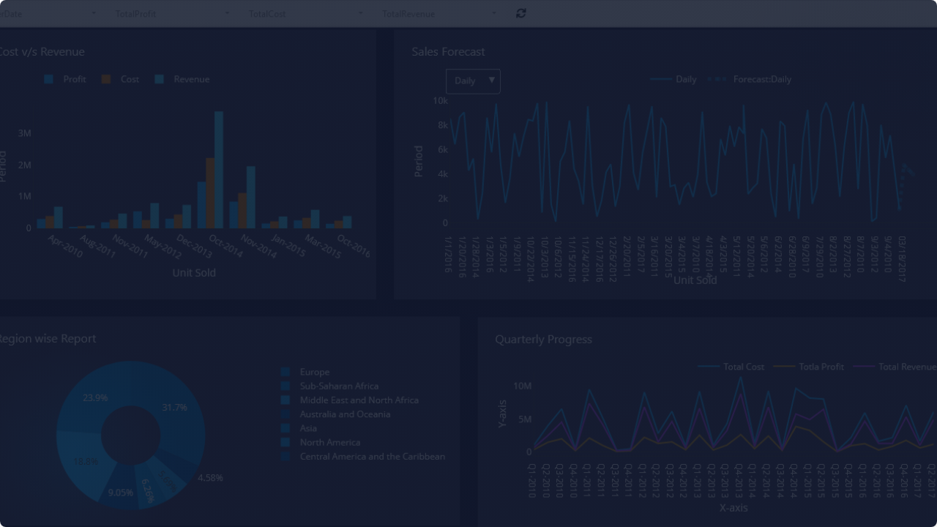
Retail Performance Snapshot
A Strategic Analysis of Sales Trends, Profitability, and Operational Efficiency.
Prepared for Leadership Review TEAM DYNAMO

Slide 2


Business Question
How can we optimize our retail performance across product categories to maximize net profitability?
Category Value: Which segments drive core profit vs. just volume?
Discount Impact: Are aggressive markdowns eroding our margins?
Inventory Planning: How does demand vary by segment?

Slide 3









Core Performance Indicators
TOTAL REVENUE
TOTAL PROFIT
PROFIT MARGIN
AVG. DISCOUNT
TOP REGION
$2.30M
$286K
12.4%
15.6%
West
Overall sales volume generated across all categories.
Net earnings after accounting for all product costs.
Standard price reduction applied across transactions.
The geographic area driving the highest revenue.

Slide 4
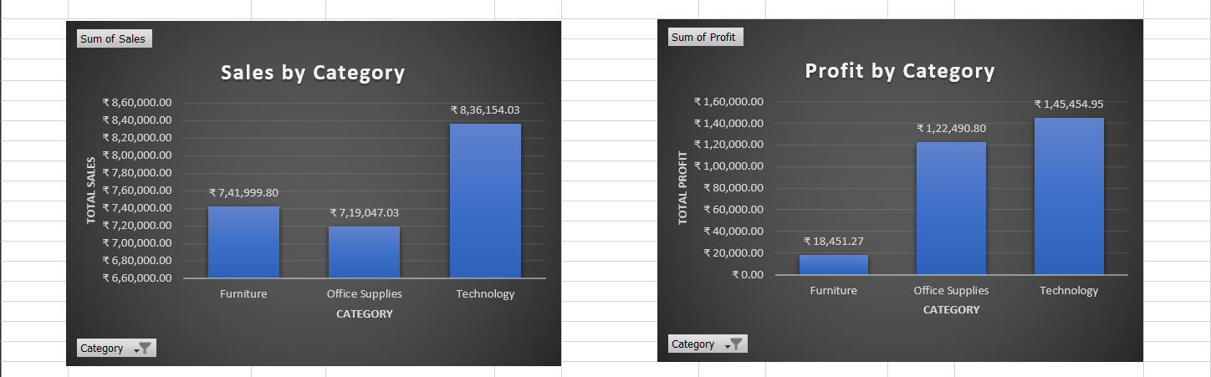
Sales and Profitability by Category
Strategic Insight: While Technology leads in value creation, high sales volume in Furniture is not yielding expected profits due to internal cost structures and discounting.

Slide 5
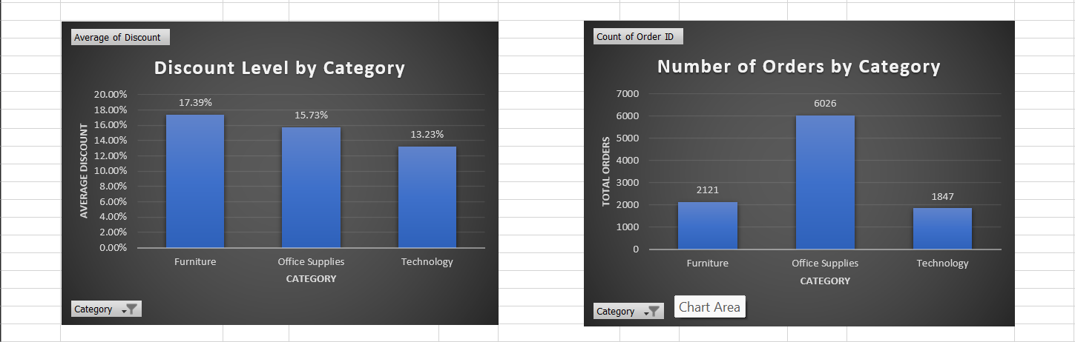
Demand and Discount Dynamics
Discounting Impact: Furniture exhibits the highest average discount rates, which directly suppresses profitability despite strong sales volume.

Slide 6


Executive Summary
Current Strengths
Primary Concerns
Technology Dominance: The category remains our most profitable segment, maintaining healthy margins despite competition.
Furniture Profit Gap: A significant disconnect exists between sales performance and profit conversion in this category.
Operational Volume: Our Office Supplies infrastructure effectively handles the highest frequency of customer transactions.
Pricing Strategy: Heavy reliance on discounts in specific categories is eroding our overall margin efficiency.

Slide 7


Recommendations
1. Prioritize Technology Growth
Allocate additional marketing and inventory resources to Technology products to capitalize on their high profit-to-revenue ratio.
2. Optimize Supply Bundling
Implement upselling or bundling strategies in Office Supplies to increase the average revenue per order and improve logistical efficiency.
Key Risk: Adjusting pricing or reducing discounts may cause short-term volume shifts. Mitigation involves targeted, category-specific pricing tests.

Slide 8


